Slide 1

Introduction to VVUQ | Example
Projectile Motion
Task Group on VVUQ Concepts in Engineering Education
ASME Codes & Standards | Committee on Verification, Validation, and Uncertainty Quantification
Contacts: Lydia Stanford (stanfordl@asme.org) | Daniel Papert (papertd@asme.org​)
V. 1, April 2026
© 2026 by ASME Task Group on VVUQ in Engineering Education is licensed under CC BY 4.0. To view a copy of this license, visit https://creativecommons.org/licenses/by/4.0/

Slide 2
Outline
The VVUQ Process
Problem & Model Definition
Sources of Uncertainty
Solution Verification
Uncertainty Quantification
Validation Assessment
Decision-Making
Conclusions
Notes:
This example is based on the VVUQ Process outlined in the companion slides found online [1]
A paper related to this example is available [2]
V. 1, April 2026

Slide 3
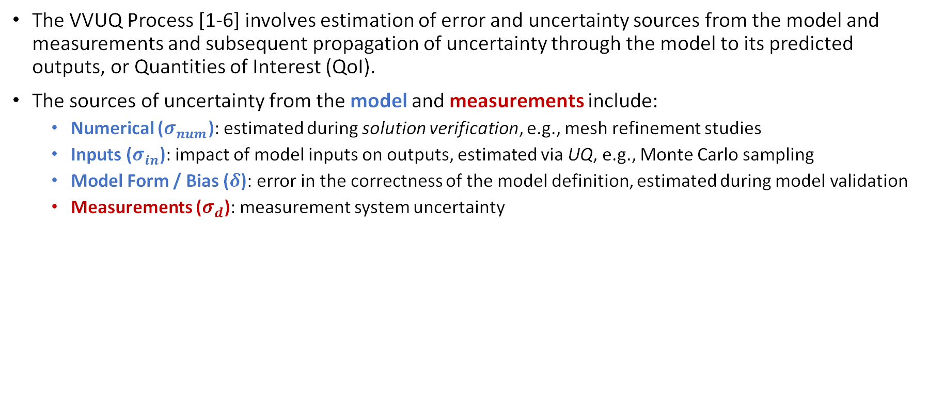







The VVUQ Process
The VVUQ Process [1-6] involves estimation of error and uncertainty sources from the model and measurements and subsequent propagation of uncertainty through the model to its predicted outputs, or Quantities of Interest (QoI).
The sources of uncertainty from the model and measurements include:
  Numerical ($σ_{num}$): estimated during solution verification, e.g., mesh refinement studies
  Inputs ($σ_{in}$): impact of model inputs on outputs, estimated via UQ, e.g., Monte Carlo sampling
  Model Form / Bias ($δ$): error in the correctness of the model definition, estimated during model validation
  Measurements ($σ_{d}$): measurement system uncertainty
Model Input Data
$x_{i}$ $i=1,2,…,N$
$$x_{i}$$
Mathematical Model
$$f\left(x_{i}\right)$$
Code Verification
Inputs
Computational Model
$$\tilde{f}\left(x_{i}\right)$$
$${\tilde{y}}_{j}$$
Model Output Data
${\tilde{y}}_{j}$ $j=1,2,…,M$
Experimental Data
$y_{j}^{d}$ $j=1,2,…,M$
Numerical
Solution Verification
Model Validation
Measurement uncertainty
Uncertainty Quantification
Model Form Error / Bias
V. 1, April 2026
Notes:
VVUQ is the workflow for judging model credibility for a specific decision. The key distinction to emphasize is that verification asks whether we solved the equations right, while validation asks whether the equations represent reality well enough for the intended use. In this example, the main uncertainty buckets are numerical uncertainty, input uncertainty, measurement uncertainty, and model-form bias.

Slide 4
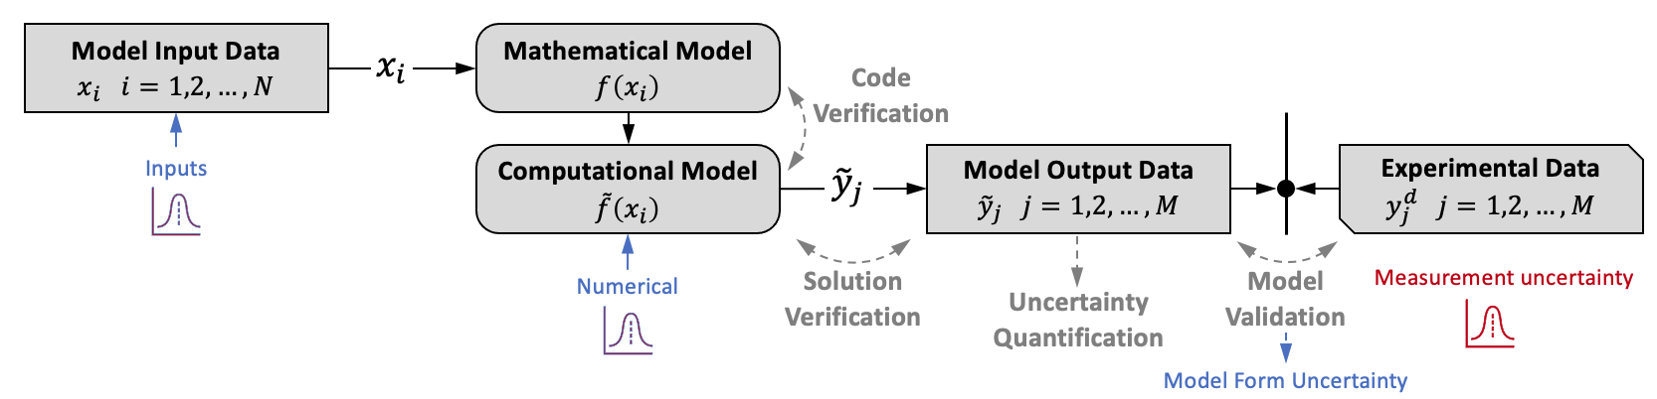
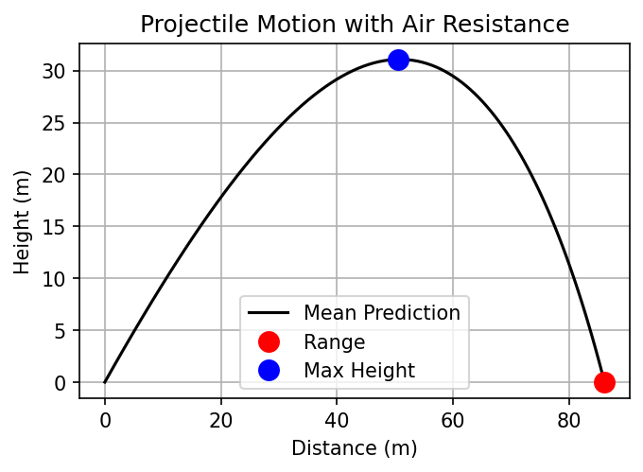
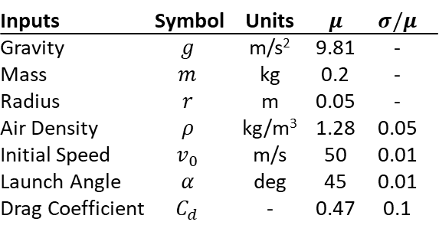
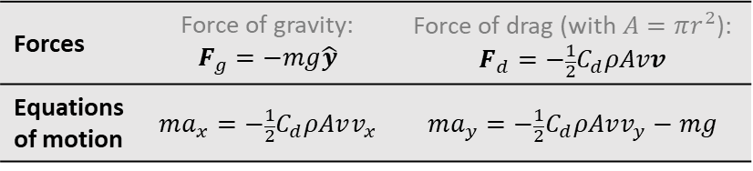
Problem & Model Definition
Problem: Develop a model to predict a spherical projectile’s flight path and then carry out VVUQ to estimate how accurately the model can predict the projectile’s range [7-9].
Model Definition: The model is defined in two steps
  The mathematical model is 2D and further assumes
    the object is a point mass, and the ground is assumed to be planar
    2 forces: quadratic drag & gravity (no wind, no spin)
    model inputs (table below right) include 4 stochastic variables
  The computational model is solved numerically and assumes
    Euler’s method [10] (to illustrate solution verification, next slide)
    code verification [3] has been performed
Forces | Force of gravity: $$F_{g}=−mg\hat{y}$$ | Force of drag (with $A=πr^{2}$): $$F_{d}=−\frac{1}{2}C_{d}ρAvv$$
Equations of motion | $$ma_{x}=−\frac{1}{2}C_{d}ρAvv_{x}$$ | $$ma_{y}=−\frac{1}{2}C_{d}ρAvv_{y}−mg$$
Inputs | Symbol | Units | $$μ$$ | $$σ/μ$$
Gravity | $$g$$ | m/s² | 9.81 | -
Mass | $$m$$ | kg | 0.2 | -
Radius | $$r$$ | m | 0.05 | -
Air Density | $$ρ$$ | kg/m³ | 1.28 | 0.05
Initial Speed | $$v_{0}$$ | m/s | 50 | 0.01
Launch Angle | $$α$$ | deg | 45 | 0.01
Drag Coefficient | $$C_{d}$$ | - | 0.47 | 0.1
V. 1, April 2026
Notes:
The projectile example is intentionally simple so students can see the full VVUQ chain. The mathematical model is a 2D point-mass projectile with gravity and quadratic drag, and it neglects wind, spin, and other effects. The computational model then adds a numerical solution method, here Euler’s method, so students can clearly see that even a physically reasonable model can still carry numerical error.

Slide 5
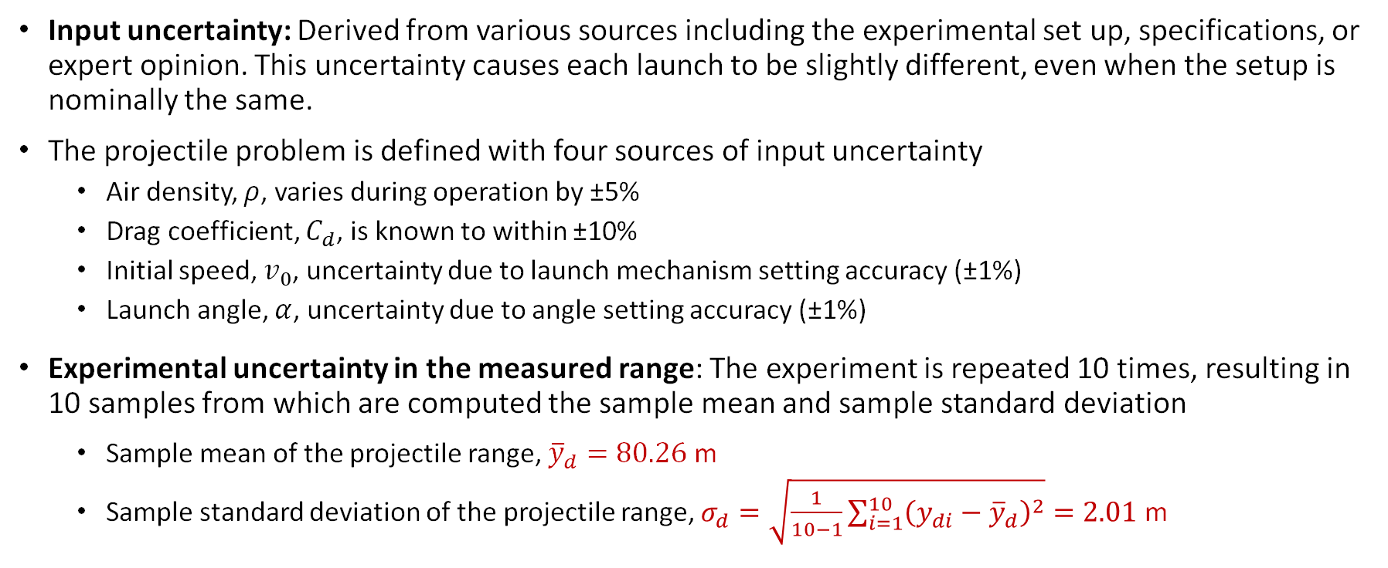
Sources of Uncertainty
Objective: Characterize uncertainty in the model inputs and measured range ($σ_{d}$)
Input uncertainty: Derived from various sources including the experimental set up, specifications, or expert opinion. This uncertainty causes each launch to be slightly different, even when the setup is nominally the same.
The projectile problem is defined with four sources of input uncertainty
  Air density, $ρ$, varies during operation by ±5%
  Drag coefficient, $C_{d}$, is known to within ±10%
  Initial speed, $v_{0}$, uncertainty due to launch mechanism setting accuracy (±1%)
  Launch angle, $α$, uncertainty due to angle setting accuracy (±1%)
Experimental uncertainty in the measured range: The experiment is repeated 10 times, resulting in 10 samples from which are computed the sample mean and sample standard deviation
  Sample mean of the projectile range, ${\overline{y}}_{d}=80.26$ m
  Sample standard deviation of the projectile range, $σ_{d}=\sqrt{\frac{1}{10−1}\sum_{i=1}^{10}{{\left(y_{di}−{\overline{y}}_{d}\right)}^{2}}}=2.01$ m
V. 1, April 2026
Notes:
A good teaching point here is that uncertainty starts before any simulation is run. Air density, launch speed, launch angle, and drag coefficient are uncertain inputs, so repeated launches are not exactly identical even under nominally identical setup.
On the measurement side, the range data are summarized from repeated tests using a sample mean and sample standard deviation; that is a practical way to characterize measurement uncertainty, though in real work the measurement model itself also matters.

Slide 6
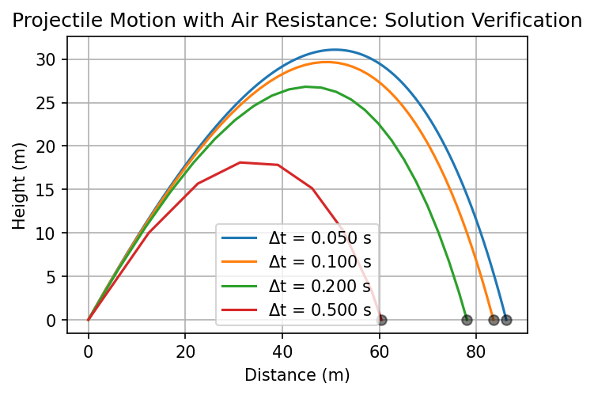
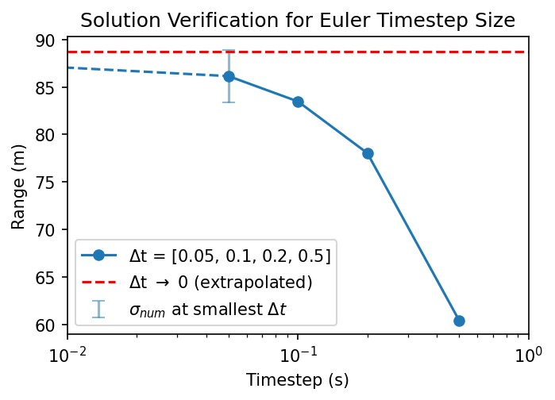
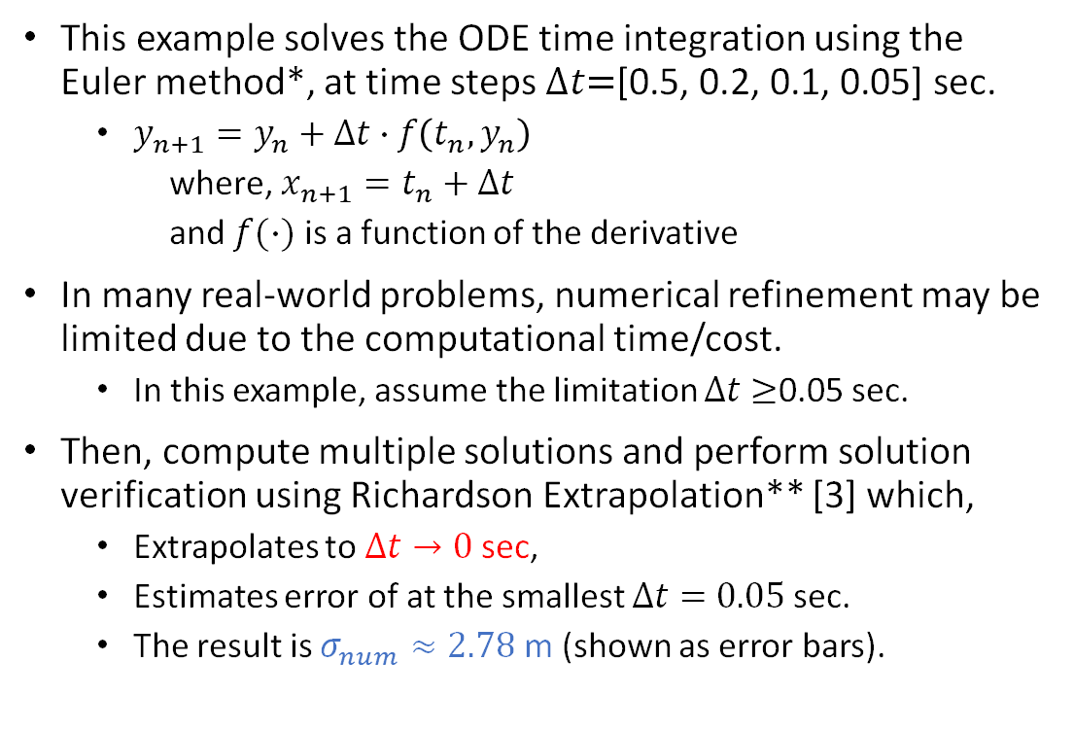
Solution Verification
Objective: Solution verification estimates the numerical error ($σ_{num}$) of the output quantity of interest.
This example solves the ODE time integration using the Euler method*, at time steps $Δt\text{=}\text{[0.5, 0.2, 0.1, 0.05]}$ sec.
  $y_{n+1}=y_{n}+Δt∙f\left(t_{n},y_{n}\right)$
  where, $x_{n+1}=t_{n}+Δt$
  and $f(∙)$ is a function of the derivative
In many real-world problems, numerical refinement may be limited due to the computational time/cost.
  In this example, assume the limitation $Δt≥$0.05 sec.
Then, compute multiple solutions and perform solution verification using Richardson Extrapolation** [3] which,
  Extrapolates to $Δt→\text{0}$ sec,
  Estimates error of at the smallest $Δt=0.05$ sec.
  The result is $σ_{num}≈2.78$ m (shown as error bars).
V. 1, April 2026
*The Euler method is taught in many college-level courses and on-line videos, e.g., see [10]. **Uses the three smallest time steps to compute numerical error.
Notes:
“Verification checks the math and numerics; validation checks the physics against reality.”
This is where students should hear: “verification is about numerics, not physics.” The example uses multiple time steps with Euler’s method to perform Richardson extrapolation to estimate the numerical error in range at the finest practical time step. That makes the point that a computed answer can be wrong simply because the discretization is too coarse, even if the governing equations are fine.

Slide 7
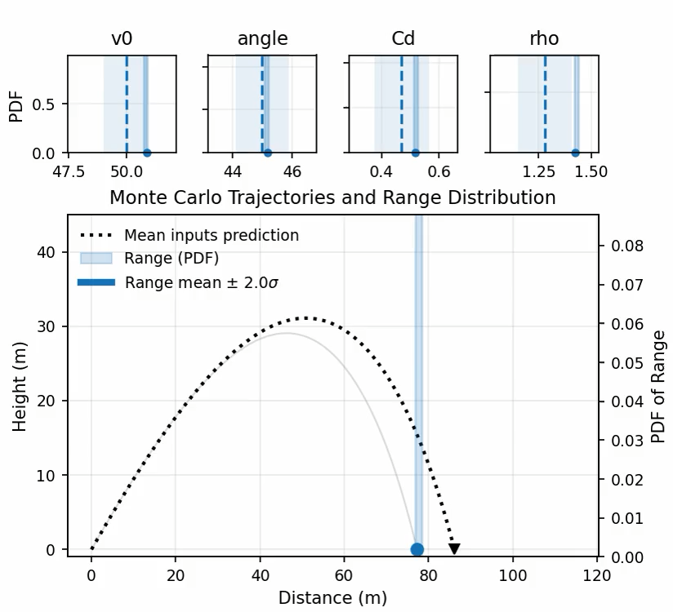
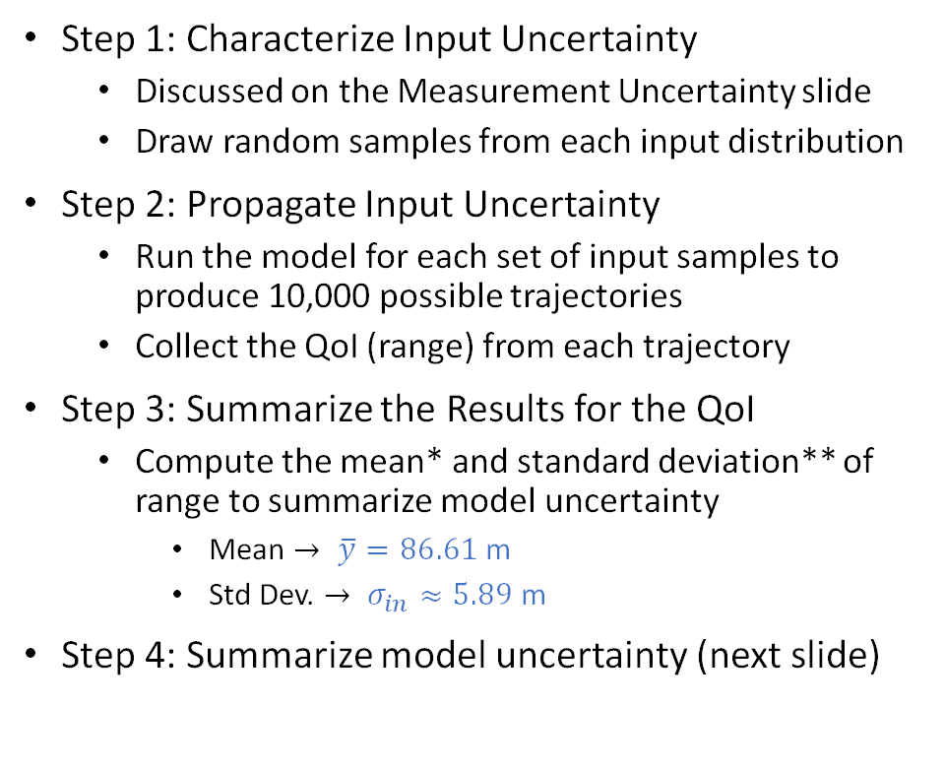
Uncertainty Quantification
Objective: Assess how uncertainty of the model inputs ($σ_{in}$) affect the model outputs.
Step 1: Characterize Input Uncertainty
  Discussed on the Measurement Uncertainty slide
  Draw random samples from each input distribution
Step 2: Propagate Input Uncertainty
  Run the model for each set of input samples to produce 10,000 possible trajectories
  Collect the QoI (range) from each trajectory
Step 3: Summarize the Results for the QoI
  Compute the mean* and standard deviation** of range to summarize model uncertainty
    Mean $→ \overline{y}=86.61$ m
    Std Dev. $→ σ_{in}≈5.89$ m
Step 4: Summarize model uncertainty (next slide)
V. 1, April 2026
* This represents the mean of the samples of range. The mean inputs produces a deterministic solution which will be different.
**For simplicity in this example we use the standard deviation. The distribution is non-normal, so percentiles may be a better choice.
Notes:
UQ begins by assigning distributions to uncertain inputs, then propagating them through the model, here with Monte Carlo sampling. The crucial part of this step is to ensure that the input distributions are well-defined. Otherwise “garbage in / garbage out”. It can also be pointed out that a very large number of Monte Carlo sampling runs of the model is required to ensure convergence of distribution quantities. This is a practical challenge in typical engineering problems and there are many approaches to dealing with this issue in the literature. Also, because the resulting output distribution may be non-normal, standard deviation is a convenient teaching summary, but percentiles can be more informative in practice. Another point made in the footnotes is the distinction between the mean of many stochastic runs is not generally the same as the deterministic result evaluated only at mean inputs when there is nonlinearity in the model.

Slide 8
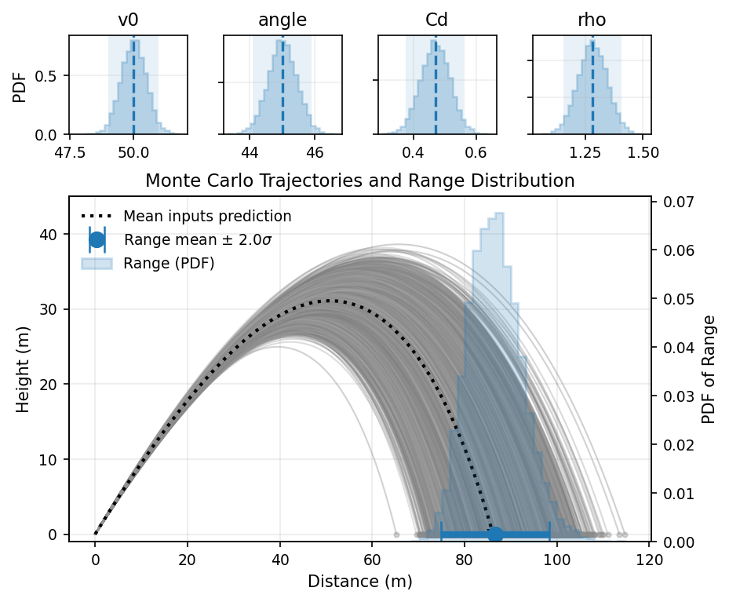
Uncertainty Quantification
Objective: Assess how uncertainty of the model inputs ($σ_{in}$) affect the model outputs.
Step 1: Characterize Input Uncertainty
  Discussed on the Measurement Uncertainty slide
  Draw random samples from each input distribution
Step 2: Propagate Input Uncertainty
  Run the model for each set of input samples to produce 10,000 possible trajectories
  Collect the QoI (range) from each trajectory
Step 3: Summarize the Results for the QoI
  Compute the mean* and standard deviation** of range to summarize model uncertainty
    Mean $→ \overline{y}=86.61$ m
    Std Dev. $→ σ_{in}≈5.89$ m
Step 4: Summarize model uncertainty (next slide)
V. 1, April 2026
* This represents the mean of the samples of range. The mean inputs produces a deterministic solution which will be different.
**For simplicity in this example we use the standard deviation. The distribution is non-normal, so percentiles may be a better choice.
Notes:
(This is an optional slide with a static UQ plot rather than animated sampling.)
UQ begins by assigning distributions to uncertain inputs, then propagating them through the model, here with Monte Carlo sampling. The crucial part of this step is to ensure that the input distributions are well-defined. Otherwise “garbage in / garbage out”. It can also be pointed out that a very large number of Monte Carlo sampling runs of the model is required to ensure convergence of distribution quantities. This is a practical challenge in typical engineering problems and there are many approaches to dealing with this issue in the literature. Also, because the resulting output distribution may be non-normal, standard deviation is a convenient teaching summary, but percentiles can be more informative in practice. Another point made in the footnotes is the distinction between the mean of many stochastic runs is not generally the same as the deterministic result evaluated only at mean inputs when there is nonlinearity in the model.

Slide 9
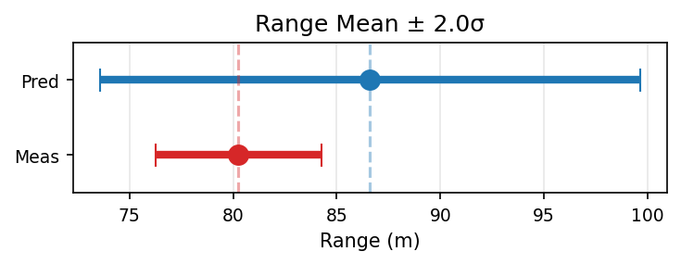
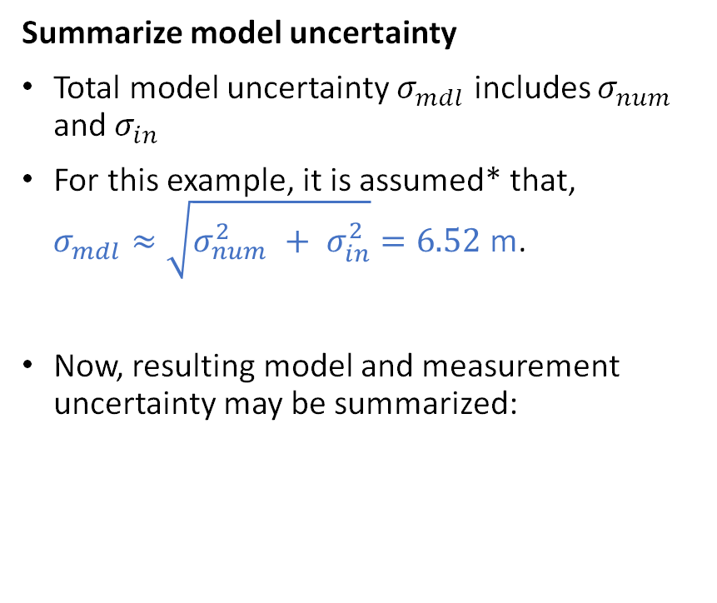
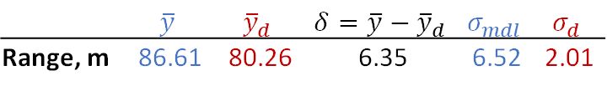

Validation Assessment
Objective: Quantitative comparison of predictions ($y$) and measured data ($y_{d}$) to assess model accuracy.
Summarize model uncertainty
Total model uncertainty $σ_{mdl}$ includes $σ_{num}$ and $σ_{in}$
For this example, it is assumed* that,
$σ_{mdl}≈\sqrt{σ_{num}^{2} + σ_{in}^{2}}=6.52$ m.
Now, resulting model and measurement uncertainty may be summarized:
Perform validation assessment
Compare $y$ and $y_{d}$ as intervals $→\overline{y}±2σ$
Consider model bias** and relative uncertainty
  Bias: $δ=\overline{y}−{\overline{y}}_{d}$ $→$ model overpredicts by 6.35 m
  $σ_{mdl}>σ_{d}→$ model has greater uncertainty
 | $$\overline{y}$$ | $${\overline{y}}_{d}$$ | $$δ=\overline{y}−{\overline{y}}_{d}$$ | $$σ_{mdl}$$ | $$σ_{d}$$
Range, m | 86.61 | 80.26 | 6.35 | 6.52 | 2.01
V. 1, April 2026
* Note: assumes approximate independence; combines error and uncertainty is typical, but it is not strictly ‘correct’
** Model bias is also known as model form error and indicates the physics of the model do not perfectly represent the physics of the experiment.
Notes:
Validation compares model predictions against experimental observations, including uncertainty on both sides. A useful classroom message is that agreement is not judged only by comparing two means; students should also compare uncertainty, look at the size of the bias, and ask whether the experiment reflects the intended use of the model. In this example, the model overpredicts range, which is interpreted as evidence of bias or missing physics, not just random scatter.

Slide 10
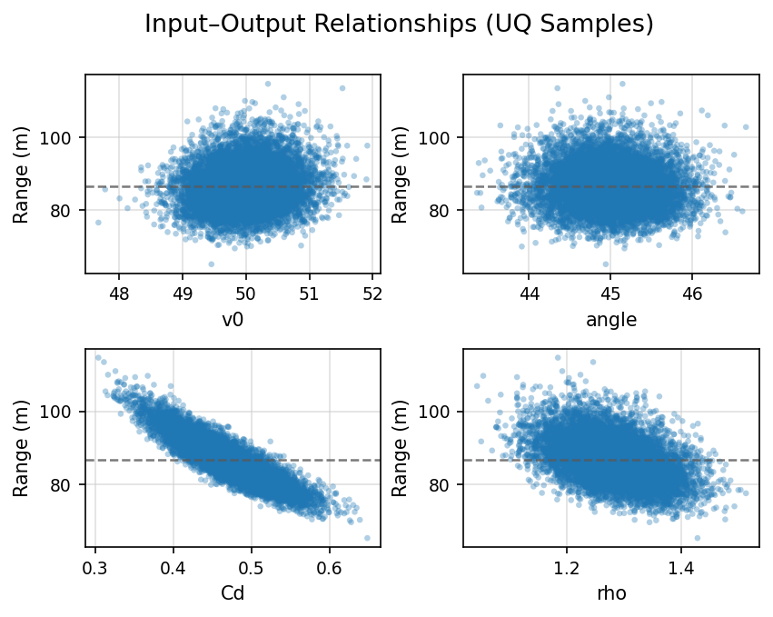

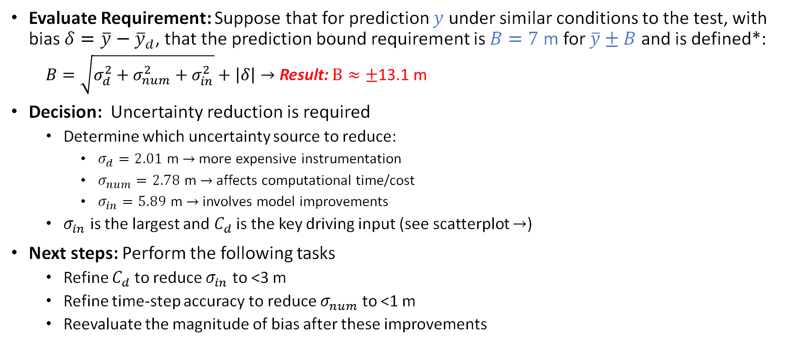
Decision-Making
Objective: Determine whether model accuracy is adequate for the intended use of the model.
Evaluate Requirement: Suppose that for prediction $y$ under similar conditions to the test, with bias $δ=\overline{y}−{\overline{y}}_{d}$, that the prediction bound requirement is $B=7$ m for $\overline{y}±B$ and is defined*:
  $B=\sqrt{σ_{d}^{2}+σ_{num}^{2}+σ_{in}^{2}}+\left|δ\right|→$ Result: $B≈±\text{13.1 }\text{m}$
Decision: Uncertainty reduction is required
  Determine which uncertainty source to reduce:
    $σ_{d}=2.01$ m $→$ more expensive instrumentation
    $σ_{num}=2.78$ m $→$ affects computational time/cost
    $σ_{in}=5.89$ m $→$ involves model improvements
  $σ_{in}$ is the largest and $C_{d}$ is the key driving input (see scatterplot $→$)
Next steps: Perform the following tasks
  Refine $C_{d}$ to reduce $σ_{in}$ to <3 m
  Refine time-step accuracy to reduce $σ_{num}$ to <1 m
  Reevaluate the magnitude of bias after these improvements
The scatterplot of UQ samples shows that input $C_{d}$ has the strongest correlation to Range, thus is most important.
V. 1, April 2026
* Estimating predictive uncertainty depends on the application and should consider credibility of the model and measurements (based on VVUQ evidence); the approach here is used for demonstration purposes.
Notes:
Decision-Making: This is where VVUQ becomes engineering rather than just statistics. The question is not “Is the model perfect?” but “Is the predictive uncertainty small enough for the requirement?” In the projectile example, the combined bound exceeds the assumed allowable prediction bound, so the correct conclusion is not blind acceptance or rejection, but targeted uncertainty reduction. Analysis of the results first reviews the three buckets of uncertainty: measurements, numerical errors, and input uncertainty. Then, since the input uncertainty is largest, it can be further interrogated using the sensitivity of the outputs to each input. One way to show this is by creating a scatterplot between Range and each input using the Monte Carlo samples generated during the UQ step (this topic area is referred to as sensitivity analysis and there are many methods for identifying the most important driving inputs). The scatter plot shows the $C_{d}$ has the strongest correlation to range and is therefore the most influential input for reducing $σ_{in}$.
Since the requirement is not met, next good steps are to
refine the uncertainty in $C_{d}$, and
reduce the time step further to increase numerical accuracy.
Once these are done, the validation step should be repeated to review the magnitude of the bias. If the bias remains unacceptably large, further model physics improvements may be required, i.e., there may be ‘missing physics’.

Slide 11
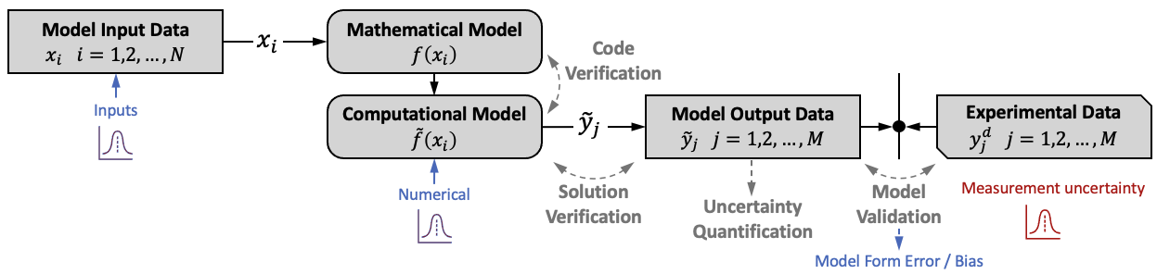
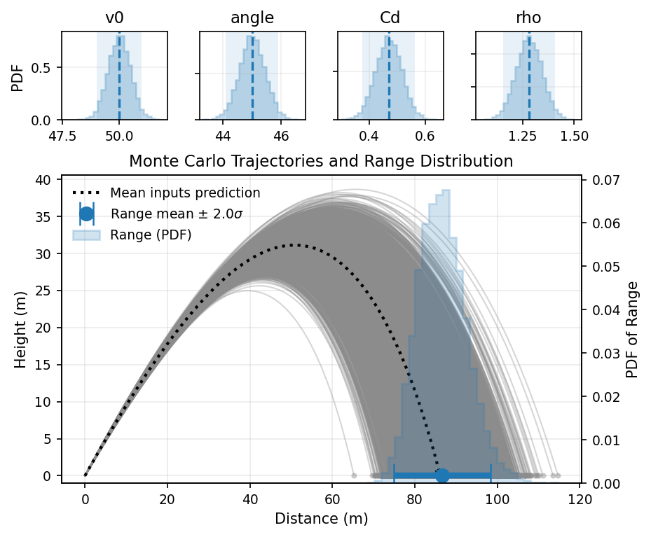
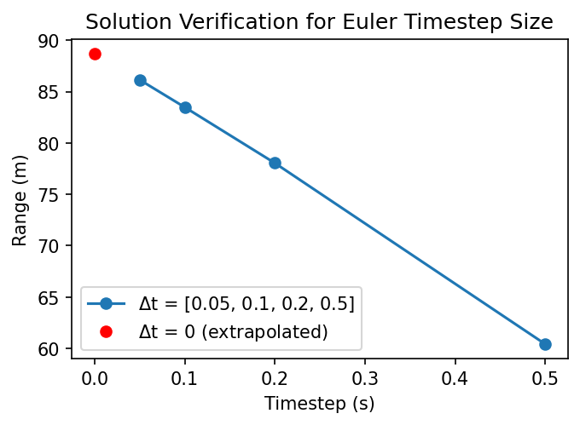
Conclusions
VVUQ links models to decisions: define the conceptual/mathematical model, solve the numerical model, quantify uncertainty, compare to data, and judge credibility for intended use.
As engineering increasingly relies on physics-based models and derivative ML/AI-enabled tools, engineers must understand how trustworthy it is for the decision being made.
Using the simple projectile motion example, we demonstrated how the VVUQ process enables the collection of evidence to support the credibility of the model for its intended use.
V. 1, April 2026
Notes:
VVUQ links models to decisions by forcing analysts to state assumptions clearly, estimate the important uncertainties, compare against data, and judge adequacy for intended use. That is increasingly important not only for classical physics models, but also for digital engineering and AI-enabled tools that depend on the model credibility of the underlying physics models. A model can be useful without being perfect, but only when its limits, uncertainty, and validation evidence are understood.

Slide 12
References
ASME VVUQ Concepts in Engineering Task Group, “Introduction to VVUQ”, 2025. https://www.asme.org/codes-standards/vvuq-standards or https://www.asme.org/codes-standards/publications-information/verification-validation-uncertainty
Eça, L., White, A., Banyay, G., Guler, I., Van Dam, N., An Educational Example of the Application of Verification, Validation, and Uncertainty Quantification, Proceedings of Verification, Validation and Uncertainty Quantification Symposium, ASME, May 2026
ASME (2009), "Standard for Verification and Validation in Computational Fluid Dynamics and Heat Transfer." American Society of Mechanical Engineers, ASME Standard V&V 20-2009(R2021), New York, NY.​
ASME (2021), “The Role of Uncertainty Quantification in Verification and Validation of Computational Solid Mechanics Models”, American Society of Mechanical Engineers, ASME Standard VVUQ 10.2-2021
Sandia National Laboratories, “ESP700: An Introduction to Verification, Validation, and Uncertainty Quantification”, July 2023. https://digitalops.sandia.gov/mediasite/Showcase/public/VideoSearch/0/ESP700/0/null/null/0/0.9330608495220702
Oberkampf, W., Roy, C., Verification, Validation, and Uncertainty Quantification in Scientific Computing, 2nd ed. Cambridge University Press, 2025. https://doi.org/10.1017/9781009031004
Hill, C., Learning Scientific Programming with Python, Second Edition, Cambridge University Press, New York USA, 2020 (Example: https://scipython.com/book2/chapter-8-scipy/examples/a-projectile-with-air-resistance/)
Young & Freedman, Sears and Zemansky’s University Physics, Addison Wesley, 2000
https://en.wikipedia.org/wiki/Projectile_motion#Trajectory_of_a_projectile_with_air_resistance
The Organic Chemistry Tutor, “Euler’s Method Differential Equations, Examples, Numerical Methods, Calculus.” YouTube. 2017. Accessed 22 Apr 2025. https://youtu.be/ukNbG7muKho?si=uOJSA39tsy0mf3VH
White, A., Mahadevan, S., Schmucker, J., Karl, A., “Multi-metric validation under uncertainty for multivariate model outputs and limited measurements”, Journal of Verification, Validation and Uncertainty Quantification, 2023.
V. 1, April 2026

Slide 13
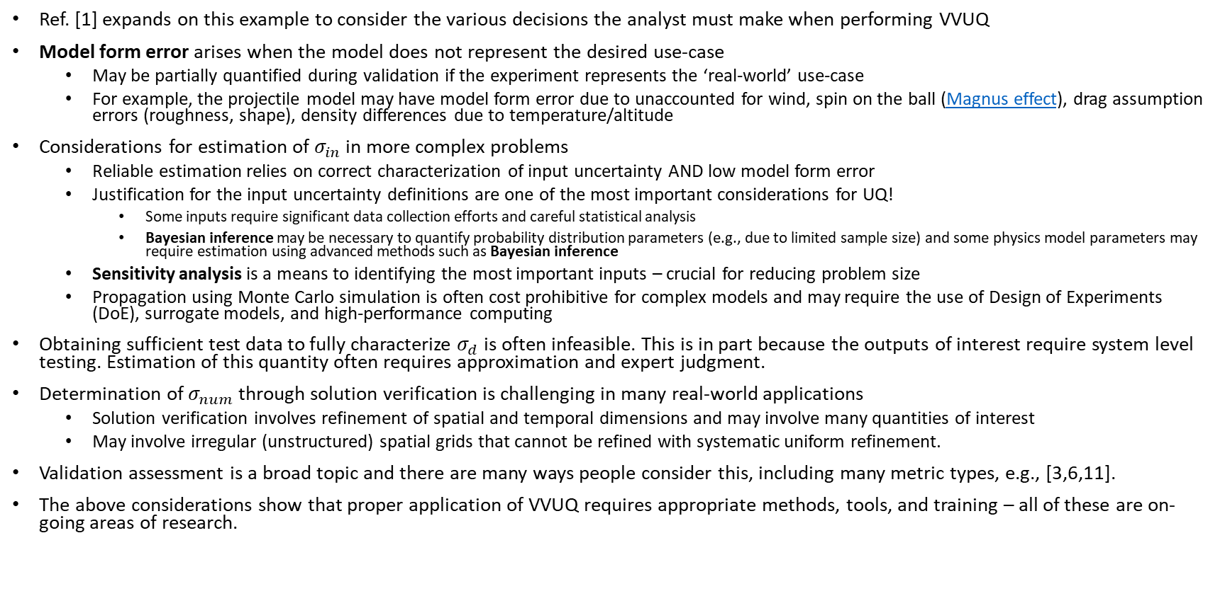
Additional Information (optional)
Ref. [1] expands on this example to consider the various decisions the analyst must make when performing VVUQ
Model form error arises when the model does not represent the desired use-case
  May be partially quantified during validation if the experiment represents the ‘real-world’ use-case
  For example, the projectile model may have model form error due to unaccounted for wind, spin on the ball (Magnus effect), drag assumption errors (roughness, shape), density differences due to temperature/altitude
Considerations for estimation of $σ_{in}$ in more complex problems
  Reliable estimation relies on correct characterization of input uncertainty AND low model form error
  Justification for the input uncertainty definitions are one of the most important considerations for UQ!
    Some inputs require significant data collection efforts and careful statistical analysis
    Bayesian inference may be necessary to quantify probability distribution parameters (e.g., due to limited sample size) and some physics model parameters may require estimation using advanced methods such as Bayesian inference
  Sensitivity analysis is a means to identifying the most important inputs – crucial for reducing problem size
  Propagation using Monte Carlo simulation is often cost prohibitive for complex models and may require the use of Design of Experiments (DoE), surrogate models, and high-performance computing
Obtaining sufficient test data to fully characterize $σ_{d}$ is often infeasible. This is in part because the outputs of interest require system level testing. Estimation of this quantity often requires approximation and expert judgment.
Determination of $σ_{num}$ through solution verification is challenging in many real-world applications
  Solution verification involves refinement of spatial and temporal dimensions and may involve many quantities of interest
  May involve irregular (unstructured) spatial grids that cannot be refined with systematic uniform refinement.
Validation assessment is a broad topic and there are many ways people consider this, including many metric types, e.g., [3,6,11].
The above considerations show that proper application of VVUQ requires appropriate methods, tools, and training – all of these are on-going areas of research.
V. 1, April 2026

