Slide 1
ASME BPE & U Certifications
BPE Committee Meetings
May 2026
Presented by Mathew Burke

Slide 2
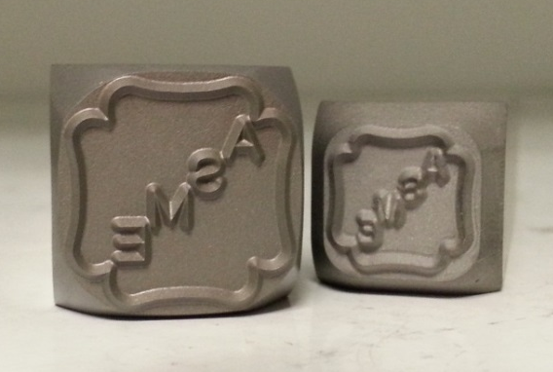
Presentation Objectives
Importance of ASME Certification
How to apply to ASME for BPE & U Certificates
Scheduling of initial certifications Survey / Joint Review
Conduct of Survey / Joint Review and Reporting back to ASME

Slide 3
Importance of ASME Certification
Having a Quality Program recognized by an independent organization that is internationally known and respected – ASME.
Supports regulatory compliance
Provides confidence to your customers that you have the knowledge and resources to implement a quality program.
Assist new suppliers gaining entry into the supply chain.
Reduce amount of time, effort and resources to purchasers in determining if a potential supplier has an acceptable quality program.
Ensures interchangeability of components from different manufacturers through defined dimensional and surface standards.
Creates a level “playing field” with promoting consistent application of the BPE standard within the industry and supply chain.
ASME IS THE ONLY CERTIFICATION!
Companies claiming certification from a supplier, a customer or anyone other than ASME are incorrect!

Slide 4
How to apply for ASME BPE & U Certifications in CAConnect
A company interesting in obtaining ASME’s BPE & U Certifications will have to create two different company records within the CAConnect System and apply for each one.
  Company Record #1 – BPE Certificate Company Record
  Company Record #2 – U Certificate Company Record – AIA Designated Oversight
Once both company records have been created and applications submitted. Two separate invoices will be generated.
Once the advanced deposit fees have been paid, along with the other required application information. Then both company records and applications will move forward to scheduling phase.

Slide 5
How to apply for ASME BPE & U Certifications in CAConnect (continued)
Be sure to read and understand “INFORMATION AND PROCEDURES FOR OBTAINING AN ASME BPE CERTIFICATE OF AUTHORIZATION OR QUALITY SYSTEM CERTIFICATE” BPE-GUI-01 05/19/2025
Form is in the process of being updated to address vessels and tanks.
  Be sure to read and understand “BOILER AND PRESSURE VESSEL CERTIFICATES OF AUTHORIZATION AND THE CERTIFICATION MARK FOR SECTIONS I, IV, VIII DIV. 1, VIII DIV. 2 VIII DIV. 3, X AND XII Informational Handbook” BPV-GUI-03 Issue 1, Rev. 2 05-12-2023

Slide 6
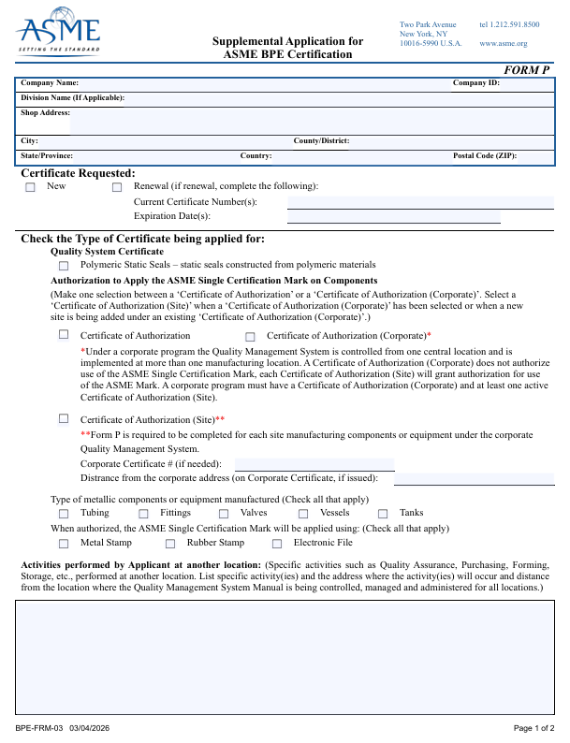
How to apply for ASME BPE & U Certifications in CAConnect (continued)
Complete Supplemental Application Form – Form P
  Select the metallic components or equipment manufactured (Check all that apply)
  Select the activities performed by Applicant (you) at another location:

Slide 7
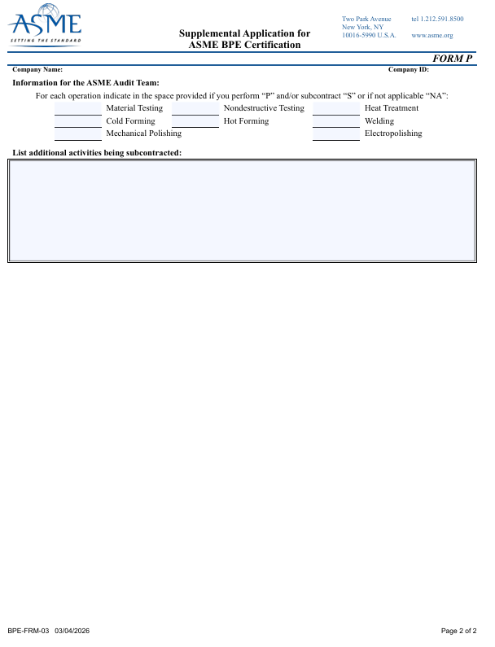
How to apply for ASME BPE & U Certifications in CAConnect (continued)
Complete Supplemental Application Form – Form P
  Select the items you perform “P” or subcontract “S”. This is required to be demonstrated.
  You must complete your internal audit of the BPE program prior to the ASME Survey. This is your chance to find all the errors before the Team arrives.

Slide 8
How to apply for ASME BPE & U Certifications in CAConnect (continued)
Complete the Application (New, Renewal or “New and Renewal” as applicable): Application must be completed and submitted through CA Connect.
For U Certificates: Upon submittal of the completed application through CA Connect, receipt of the completed ASME Accreditation/Certification Agreement form, and the proper fees, ASME will request from the Applicant’s Authorized Inspection Agency (AIA) verification of an agreement for third party inspection and will verify the application for completeness. Once the Agreement with the AIA has been verified and the application reviewed for completeness, ASME will move forward with scheduling the Joint Review.

Slide 9
How to apply for ASME BPE & U Certifications in CAConnect (continued)
Be sure to list any information you believe the Team should be aware of and helpful in conducting the Survey/Joint Review. (Short Work Week and Schedule, Multiple Shifts, etc. )
  Be Honest! If you do not want scheduled for a holiday week or if you only work a four 10-hour days – List it!

Slide 10
Scheduling of initial Certifications Survey
The ASME Scheduling Team will look at both company applications and the availability provided by the company. ASME Scheduling Team is working 3-4 months in advance.
Note: For Renewal of Certificates of Authorization, Certificate Holders are reminded by ASME ten months prior to the expiration date of the Certificates because of the time involved in the renewal process, which must be completed before the expiration date. ASME requests that you give this matter your immediate attention and complete the application in a timely manner.
Each company record will have Survey/Joint Review dates entered into the CAConnect system. ASME intends on scheduling these together so that the Survey Team is only making one trip to the company’s facility.
Applicant Company must “Acknowledge/Accept” the dates in the CAConnect system.

Slide 11
Scheduling of initial Certifications Survey (continued)
4. Once the Survey/Joint Review dates have been scheduled and confirmed. Company should begin final preparations and making sure they are ready for the Survey and Joint Review Teams’ arrival in a few months.
Manual Checklists for both certifications are available for reference and are required to be completed
ASME BPE QUALITY MANAGEMENT SYSTEM (QMS) CHECKLIST BPE-FRM-04 8/11/2025
GUIDE FOR ASME APPLICANTS TO BE USED BY ASME REVIEW TEAMS FOR OBTAINING ASME CERTIFICATES OF AUTHORIZATION
VERY IMPORTANT – Be Sure to Read and Follow the Introduction

Slide 12
Scheduling of initial Certifications Survey (continued)
5. ASME initially intends on scheduling these combined certification activities for four days, with two auditors.
  A stand alone BPV Joint Review is normally scheduled for two days, one auditor.
  A stand alone BPE Survey is normally scheduled for three days, two auditors.
Key Points of the ASME BPE QUALITY MANAGEMENT SYSTEM (QMS) CHECKLIST Introduction
a. “Checklist is provided to Applicants for their use in verifying and identifying the paragraph(s) where their QMS Manual…”
1. “In their Manual” - Not Procedures, Work Instructions, Etc.
2. The QMS Manual must contain the controls
3. The QMS Manual is not a reiteration of the requirements specified in the ASME BPE Standard, but rather an auditable Manual which identifies who, what, when, where & how = (CONTROLS)

Slide 13
Scheduling of initial Certifications Survey (continued)
Reiteration – DO NOT COPY AND PASTE BPE/U requirements and call that a manual. Your manual is required to contain YOUR controls.
Every Question should have either an N/A (Not Applicable to your program) or a Paragraph Reference
It is recommended that the Manuals not be written to address both programs (BPE/U); I recommend only addressing the requirements of the ASME BPE Standard and the U Certificate separately in two separate manuals.

Slide 14
Scheduling of initial Certifications Survey (continued)
The Manual needs to describe the scope of the items, products and services provided by the organization.
The Manual must be in written in English. A version of the Manual may be in one’s native language; however, the English version will govern.
The QMS shall include a policy statement indicating management authority and responsibility.

Slide 15
Scheduling of initial Certifications Survey (continued)
A controlled copy of the organization’s QMS shall be provided and retained by ASME. ASME shall be provided a copy of all revisions. This needs to be described in your BPE manual.
The BPE Quality Management System will be accepted by the ASME Team Leader and the U Certification Quality Management/Quality Control Manual will be accepted by the Authorized Inspector working for the AIA or Record.
The Manual accepted by ASME is the guide for performing the audits and determining compliance

Slide 16
Conduct of Survey
The Team Leader assigned to both company applications will be in contact with the applicant several weeks prior to their visit.
Your application page on CA Connect states:
  Hotel Reservation Check-in: The night prior to the first day of your company’s survey as scheduled.
  Hotel Reservation Check-Out:The last day of the survey as scheduled.
  Hotel Meeting Room Reservation: 9:00 a.m. – 8:00 p.m. on the first day of your survey (at the hotel where the sleeping room reservations have been made for the survey team)
- Refer to the Lodging and Meeting Room Criteria on CA Connect.
You are required to make Hotel Meeting and Sleeping Room Reservations for the team.

Slide 17
Conduct of Survey
Quantity of Copies, Quality Program Documents (Manual and Referenced Procedures and Forms) including the checklist.
  One Set for each team member.
Since there are many ways to meet code requirements, the applicant company and Teams will work out a schedule that makes sure the Survey/Joint Review Team sees and reviews everything it needs to, only then can the Teams formulate a recommendation back to ASME.

Slide 18
Conduct of Survey
ALL ASPECTS OF YOUR PROGRAM IS REQUIRED TO BE DEMONSTRATED!
For Example:
  If you do Mechanical Polishing, Electropolishing, Cold Forming, Welding, Hot Forming – Demonstration(s) are required.
  If you Subcontract operations – Demonstration(s) are required
    One demonstration item can cover multiple operations

Slide 19
Reporting back to ASME
The Survey Team and assigned Team Leader will be generating two recommendations and two reports back to ASME.
  One recommendation and report specific to the Committee on BPE Certification (CBPEC).
  Second recommendation and report specific to U-Certificate.
The BPE Survey Report and recommendation will be reviewed by CBPEC for final authorization.
The U-Certificate report will be reviewed by ASME BPV Program Engineers. If needed, the report would be sent to the Committee on Boiler Pressure Vessel Conformity Assessment (CBPVCA) for review and action.

Slide 20
Reporting back to ASME
The BPE Survey will be supplemented by one annual audit.
  The audit consist of only one ASME consultant.
  ASME will schedule the audit.

Slide 21
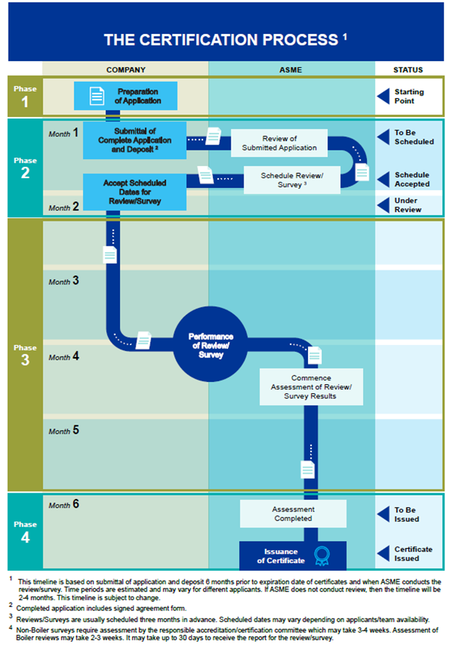
How long will this process take?

Slide 22

Questions / Discussion
Michael Frediani – ASME Director of Auditing & Conformity Assessment
fredianim@asme.org

